Slide 1
Entity-Relationship Modeling

Slide 2
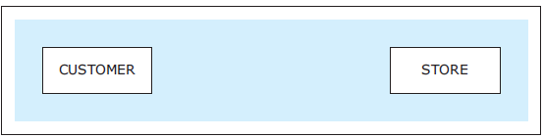
Basic ER Modeling Construct
A database can be modeled as: a collection of entities, relationship among entities.
Entities - constructs that represent what the database keeps track of
An entity is an object that exists and is distinguishable from other objects.
Represent various real world notions, such as people, places, objects, events, items, and other concepts
The basic building blocks of an ER diagram
Within one ERD each entity must have a different name
Example: specific person, company, event, plant
Basic building blocks of an ER diagram

Slide 3
ENTITIES / SETS
Entity instances (entity members one entity sets) - occurrences of an entity
Entities themselves are depicted in the ER diagrams while entity instances are not
Entity instances are eventually recorded in the database that is created based on the ER diagram
An entity set (or entity instances) is a set of entities of the same type that share the same properties.
Example: set of all persons, companies, trees, holidays

Slide 4
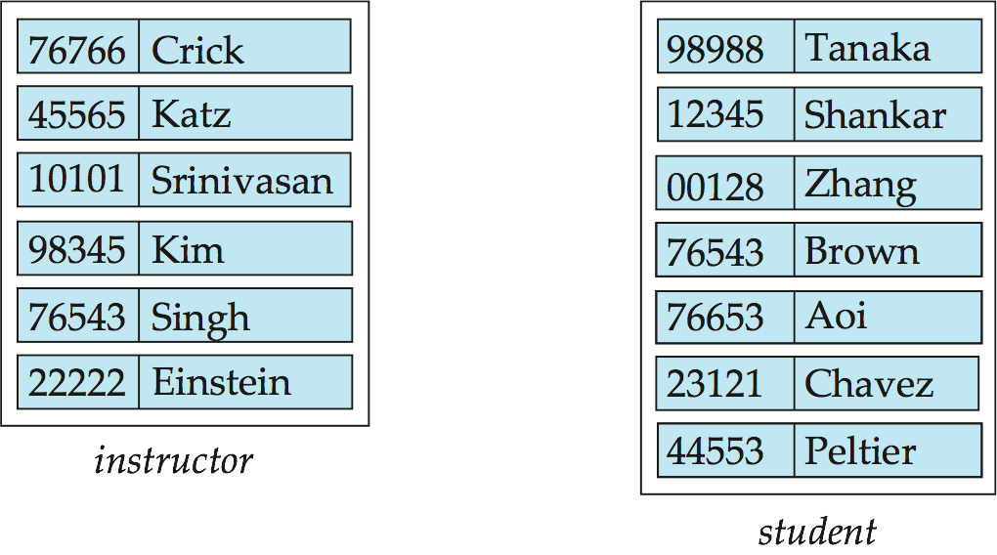
Entity Sets instructor and student
Entity instances (Sets)
instructor_ID instructor_name student-ID student_name

Slide 5
Database Requirements & ER Modeling
Database Design
Database requirements
Statements that define the details and constraints of the data and metadata for the database being developed.
Multiple sources for the requirements
What the database keeps track of and in what fashion
Entity-relationship (ER) modeling
Conceptual database modeling method that allows us to structure and organize requirements graphically
ER diagram (ERD) - the result of ER modeling
Serves as a blueprint for the database
COLLECT DATABASE REQUIREMENTS AND VISUALLY REPRESENT THEM USING ER MODELING TECHNIQUE

Slide 6
ER Diagram
The results of ER modeling is an ER Diagram (ERD)
Blueprint for the database
2 basic ER diagram construct
Entity
Relationship
Notation
Every … has own notation
No standard
Will present one notation (and show you alternatives at the end)
ER Tools
Erplus.com (uses our notation)

Slide 7

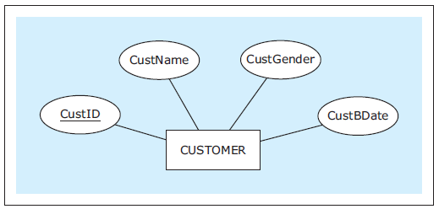
Entities
Entities: are constructs that represent what the database keeps track of
Entity with Attributes

Slide 8
Attributes
An entity is represented by a set of attributes, that is descriptive properties possessed by all members of an entity set.
Example:
instructor = (ID, name, street, city, salary ) course= (course_id, title, credits)
An attribute describes a characteristic of an entity
Domain – the set of permitted values for each attribute
Attribute types:
Simple
Composite
Optional (Null allowed)
Multivalued attributes. Example: phone_numbers an instructor might have more than one phone number
Derived attributes
Can be computed from other attributes (age, given date_of_birth)

Slide 9
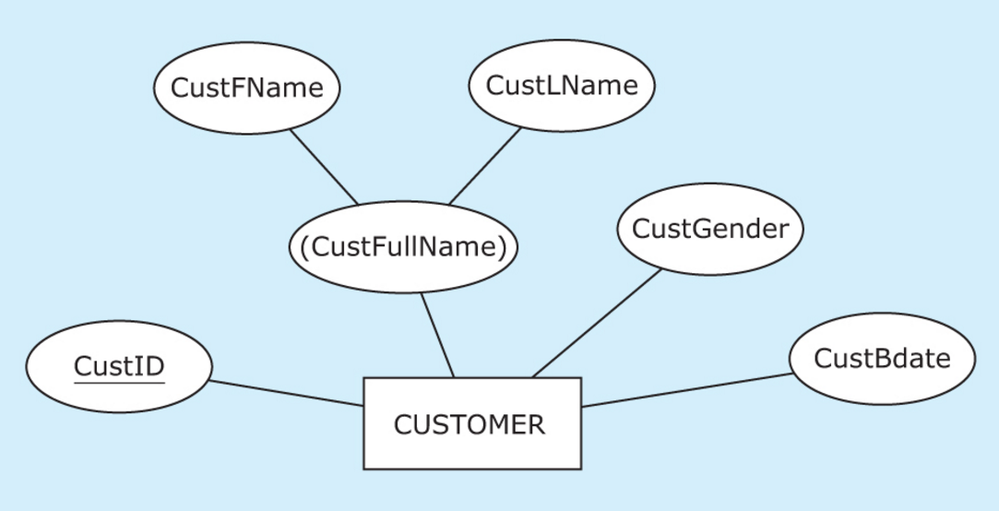
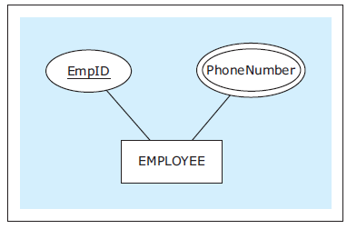
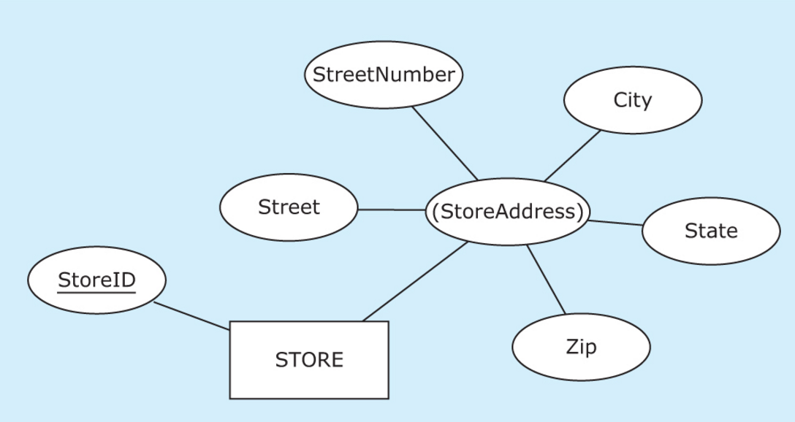
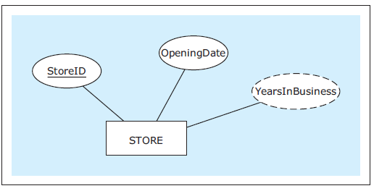
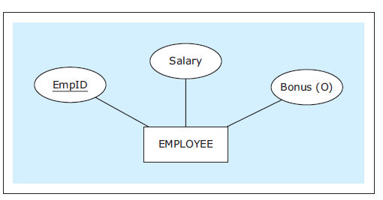
Attributes in ERD
CustFullName is Composite
PhoneNumber is Multivalued
CustID is Unique
YearInBusiness can be Derived
Bonus is Optional

Slide 10
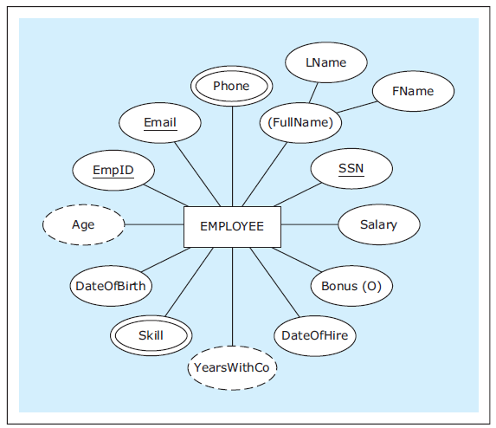
Examples
EXAMPLE: An entity with various types of attributes

Slide 11
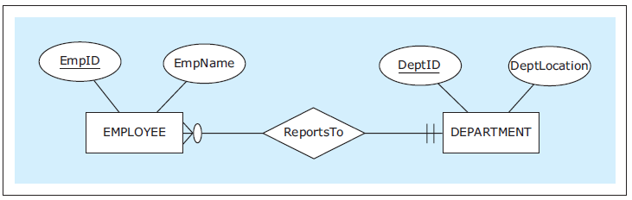
Relationship Between 2 Entities
Relationship - ER modeling construct depicting how entities are related
Each entity must be related to at least one other entity via a relationship
Lines connecting relationships to the entities include symbols depicting how many instances of one entity can be associated with instances of another entity.

Slide 12

Cardinality Constraints
Cardinality constraints - depict how many instances of one entity can be associated with instances of another entity
Maximum cardinality
One (represented by a straight bar: I)
Many (represented by a crow’s foot symbol)
Minimum cardinality (participation)
Optional (represented by a circular symbol: 0)
Mandatory (represented by a straight bar: I)

Slide 13
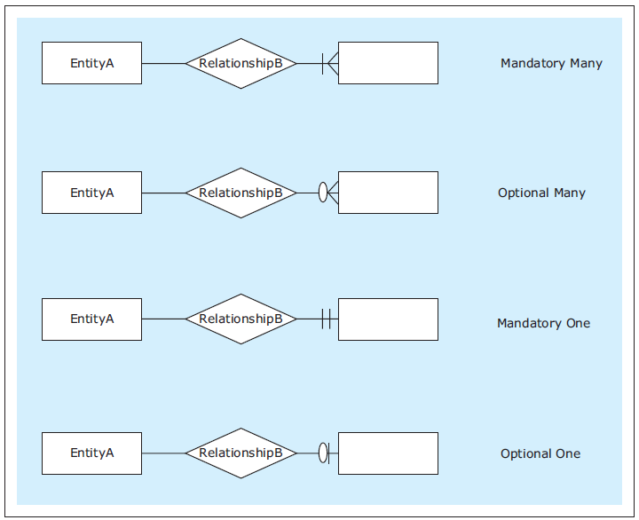
RELATIONSHIPS
Four possible cardinality constraints

Slide 14
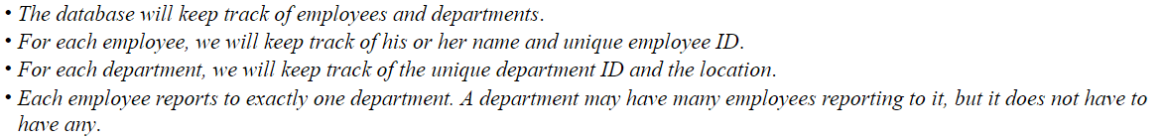
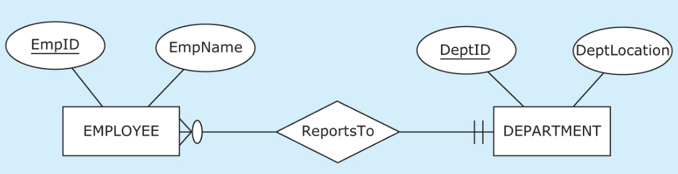
Cardinality Constraints
Maximum cardinality can either be:
One (straight bar: |) or
Many (represented by crow’s foot symbol: )
Minimum cardinality (participants) can be:
Optional (represented by circular symbol: ) or
Mandatory (straight bar: |)
Database Requirements
EMPLOYEE must report to at least one department (Min =1)
DEPARTMENT does not have to have any employees reporting to it
(Min = 0 - optional)
DEPARTMENT may have many employees reporting to it
(Max = many)
each EMPLOYEE can report to at most one department (Max =1)
Reading both together indicates: Each Employee reports to exactly one department

Slide 15
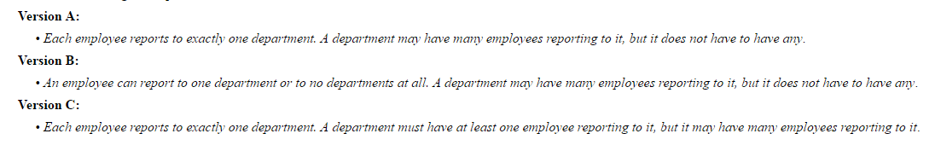
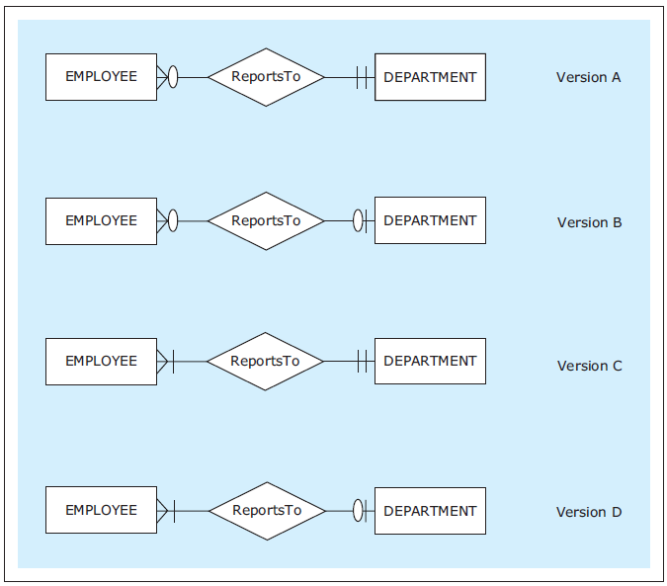

Slide 16
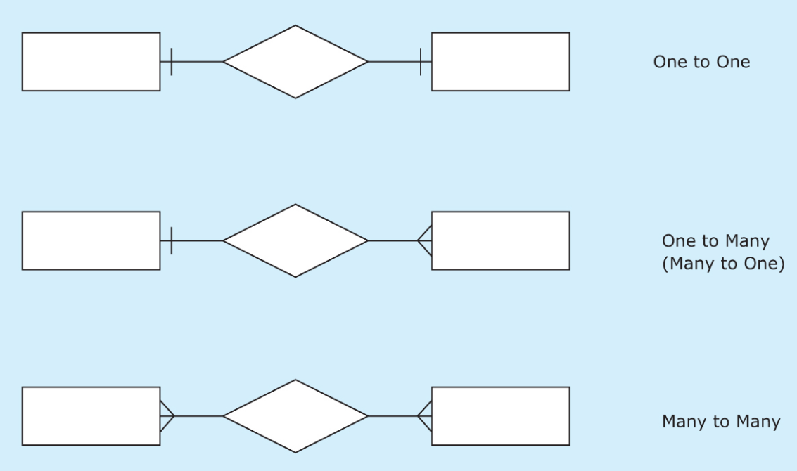
Mapping Cardinality Constraints
Express the number of entities to which another entity can be associated via a relationship set.
Most useful in describing binary relationship sets.
For a binary relationship set the mapping cardinality must be one of the following types:
One to One (1:1)
One to Many (1:M)
Many to One (M:1)
Many to Many (M:N)

Slide 17
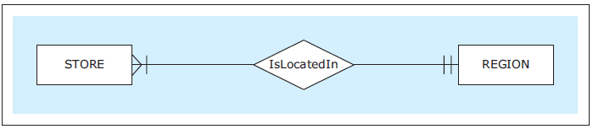
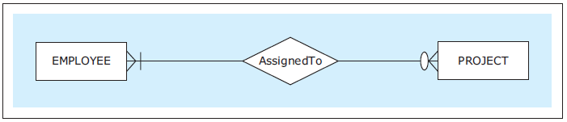
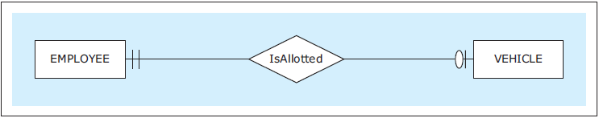
Examples
1:M Each STORE isLocatedIn exactly on REGION. Each REGION must have at least one STORE isLocatedIn it, but it may have many stores isLocatedIn it.
M:N An EMPLOYEE may be assignedTo a number of projects, but she can also be assignedTo none of the projects. A PROJECT must have at least one EMPLOYEE assignedTo it, but it may have many.
1:1 Each EMPLOYEE IsAllocated one VEHICLE or no vehicles. Each VEHICLE IsAllocated exactly one MPLOYEE

Slide 18
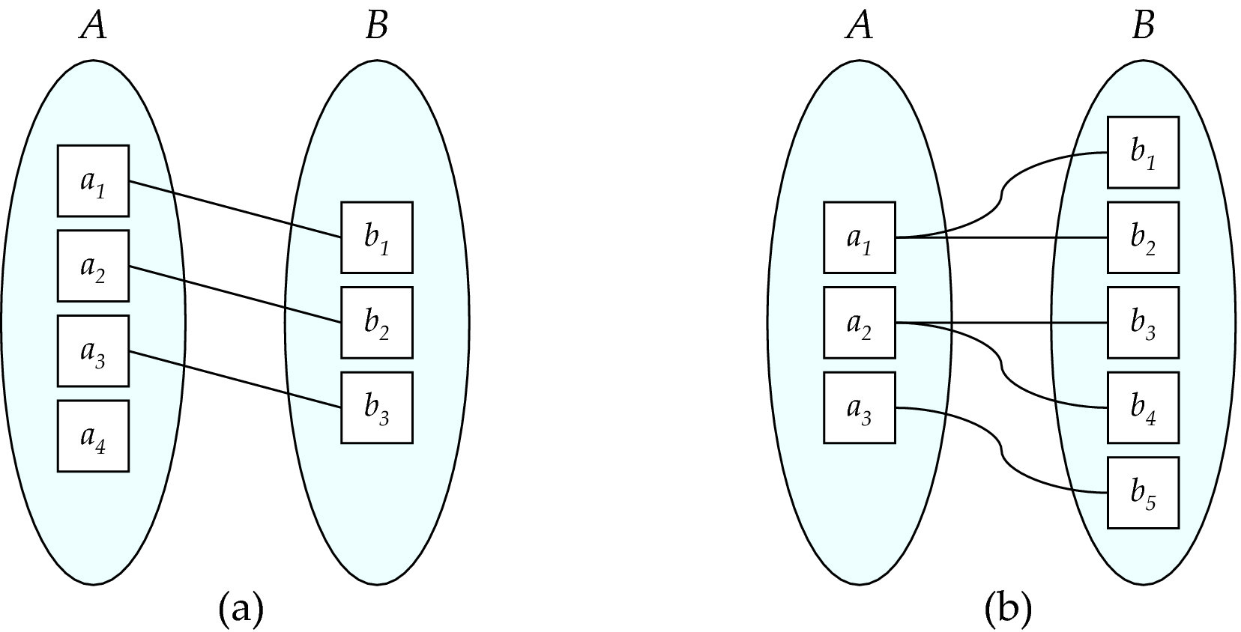
Mapping Cardinalities
One to one
One to many
Note: Some elements in A and B may not be mapped to any
elements in the other set

Slide 19
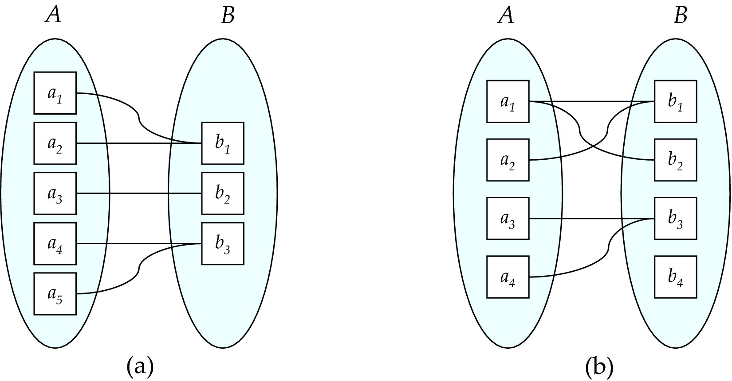
Mapping Cardinalities
Many to one
Many to many
Note: Some elements in A and B may not be mapped to any
elements in the other set

Slide 20
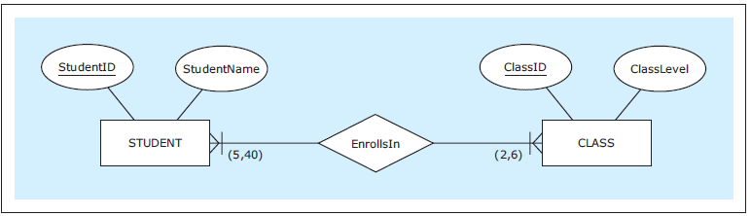
RELATIONSHIPS
A relationship with specific minimum and maximum cardinalities
Notes:
This example is discussed on Page 27.

Slide 21
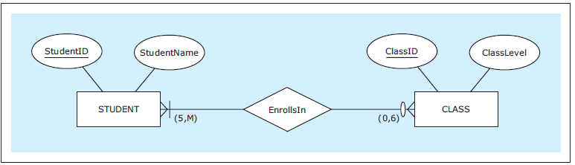
RELATIONSHIPS
A relationship with a mixture of specific and non-specific cardinalities
Notes:
This example is discussed on Page 28.

Slide 22
Relationship Instances
Relationship instances - occurrences of a relationship
Occur when an instance of one entity is related to an instance of another entity via a relationship
Relationship themselves are depicted in the ER diagrams while relationship instances are not
Relationship instances are eventually recorded in the database that is created based on the ER diagram

Slide 23
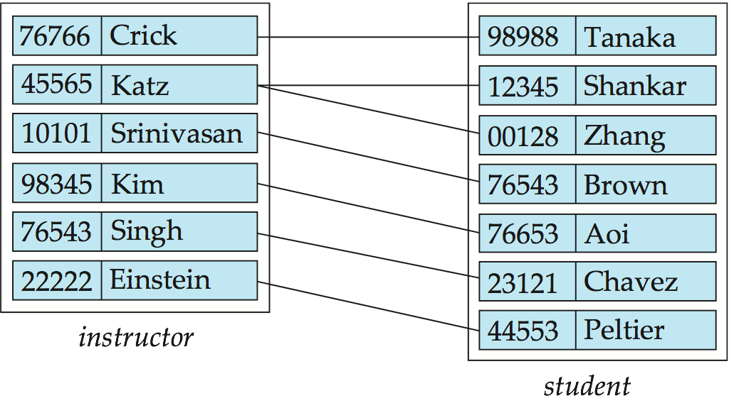
Relationship Set/instance advisor

Slide 24
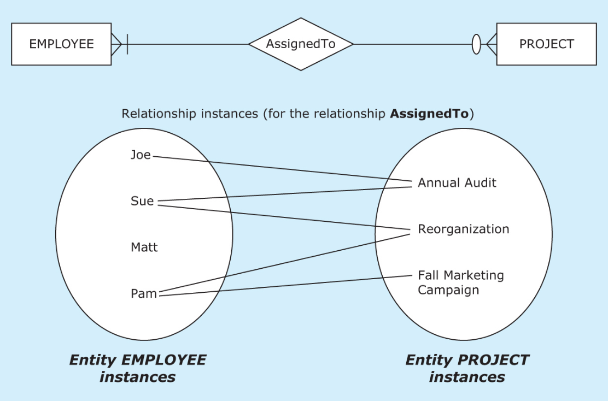
Relationship and its Instances
EMPLOYEE has optional participation (see Matt)
PROJECT has mandatory participation (every instance of entity PROJECT is connected to at least one instance of entity MPLOYEE.
Also M:N is shown.

Slide 25
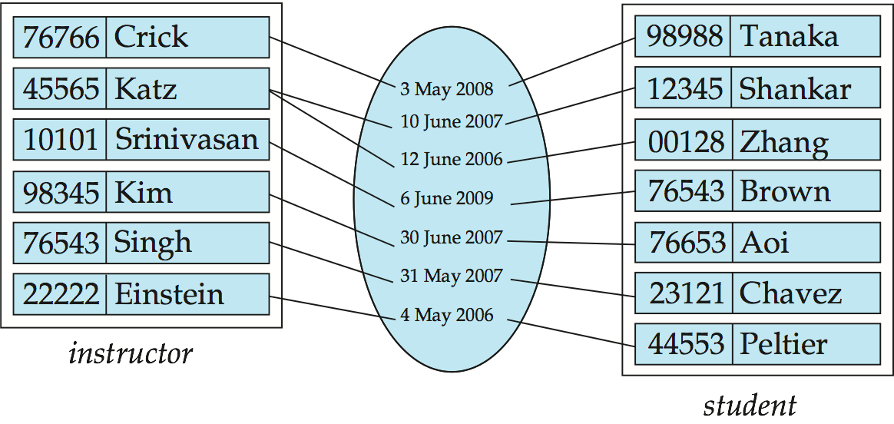
Relationship Attributes
Many-to-Many relationships can have attributes of their own called relationship attribute (property of a relationship set)
For instance, the advisor relationship set between entity sets instructor and student may have the attribute date which tracks when the student started being associated with the advisor

Slide 26
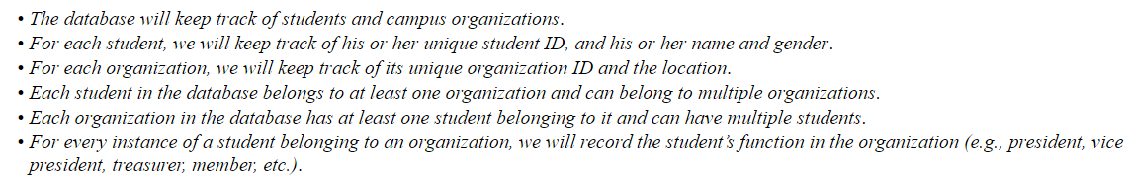
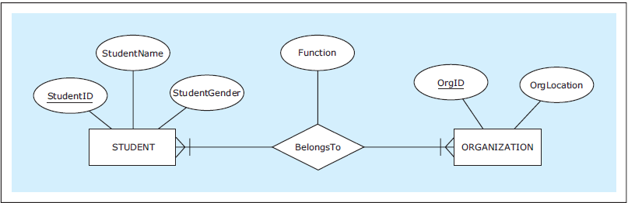
Relationship Attributes
Good slide for midterm exam – really good

Slide 27
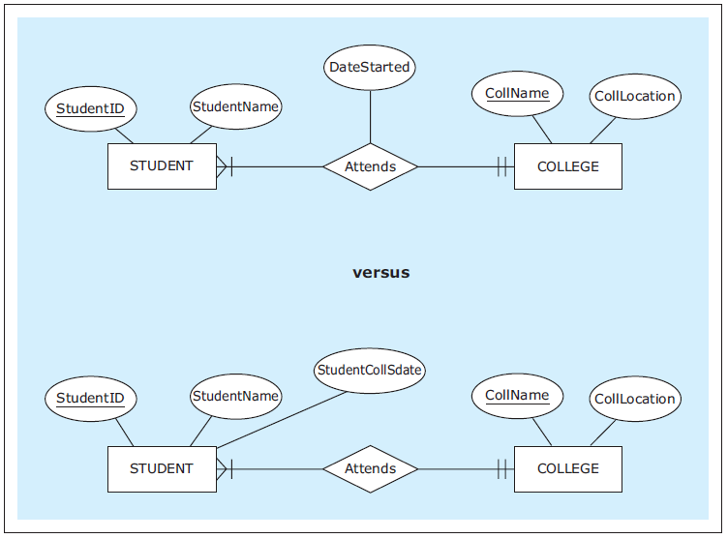
RELATIONSHIPS with Attribute
A 1:M relationship with and without an attribute
Notes:
The requirements and the discussion of the two ER diagrams shown here are given on Page 20.

Slide 28
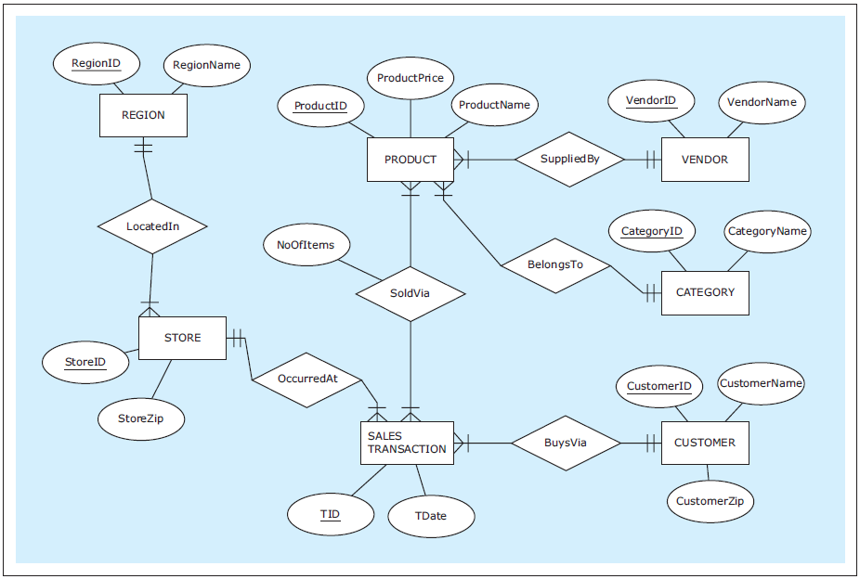
ER diagram example: ZAGI Retail Company Sales Department Database
Notes:
ZAGI Retail Company Sales Department Database requirements are given on Page 21.
The knowledge of ER notation helps database requirements collectors gather structured and useful requirements for the future database.
Knowing that an ER diagram has to be developed upon the completion of the database requirements process helps database requirements collectors focus on asking the right questions. Examples of such questions are given on Page 22.

Slide 29
Degree of a Relationship Set
Degree of a relationship - reflects how many entities are involved in the relationship
binary relationship
involve two entity sets (or degree two).
most relationship sets in a database system are binary.
Ternary relationship
Involves 3 entities
Example: students work on research projects under the guidance of an instructor.
relationship proj_guide is a ternary relationship between instructor, student, and project
Unary relationship (recursive relationship)
Occurs when an entity is involved in a relationship with itself.

Slide 30
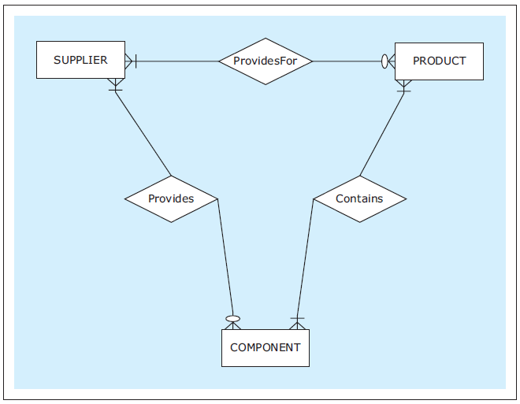
TERNARY RELATIONSHIP
Three binary relationships that are insufficient for depicting given requirements
Notes:
This example is discussed on Pages 45-46.

Slide 31
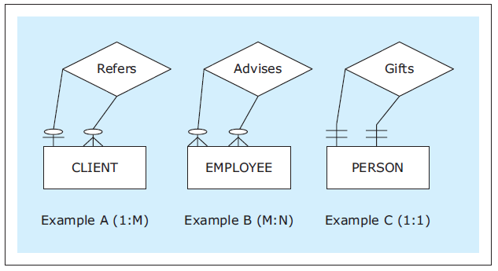
RELATIONSHIPS
Unary relationship examples
Notes:
This example is discussed on Page 28.

Slide 32
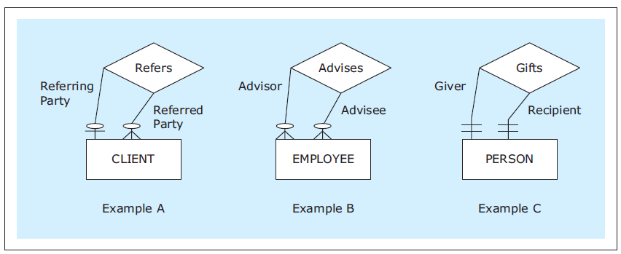
Relationship role
Relationship roles - additional syntax that can be used in ER diagrams at the discretion of a data modeler to clarify the role of each entity in a relationship
Each occurrence of an entity set plays a “role” in the relationship
Useful in unary relationships

Slide 33
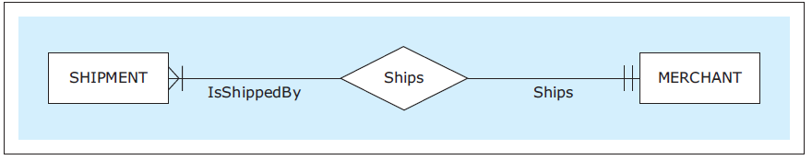
RELATIONSHIPS
A binary relationship with role names
Notes:
The same ER diagram without the relationship roles would be just as informative, while containing less verbiage.

Slide 34
WEAK ENTITY
Weak entity - ER diagram construct depicting an entity that does not have a unique attribute of its own
Owner entity - entity whose unique attribute provides a mechanism for identifying instances of a weak entity
Identifying relationship - relationship between a weak entity and its owner entity in which each instance of a weak entity is associated with exactly one instance of an owner entity
Each weak entity must be associated with its owner entity via an identifying relationship
Unique attribute from the owner entity uniquely identifies every instance of the weak entity via an identifying relationship
Partial key - attribute of a weak entity that combined with the unique attribute of the owner entity uniquely identifies the weak entity's instances
Combination of the partial key and the unique attribute from the owner entity uniquely identifies every instance of the weak entity

Slide 35
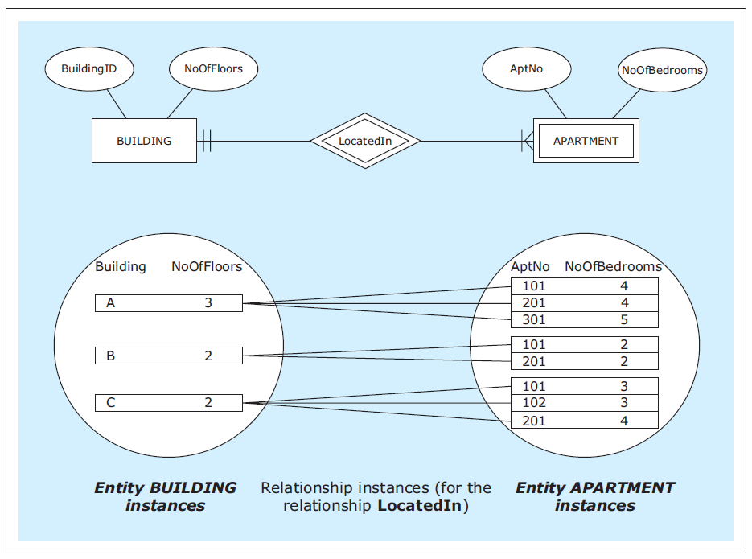
Weak Entities
discriminator or partial key
Owner
Weak entity
AptNo is unique within each building only.

Slide 36
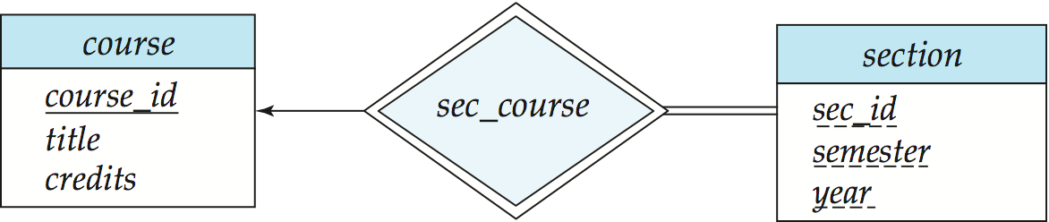
Weak Entity Sets (Cont.)
We underline the discriminator of a weak entity set with a dashed line.
We put the identifying relationship of a weak entity in a double diamond.
Primary key for section – (course_id, sec_id, semester, year)

Slide 37
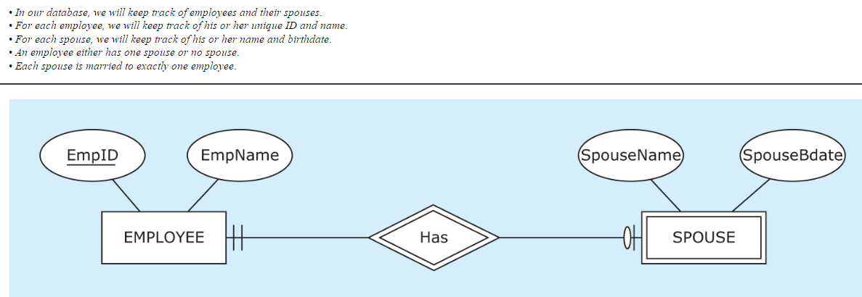
Weak Entity Sets (Cont.)

Slide 38
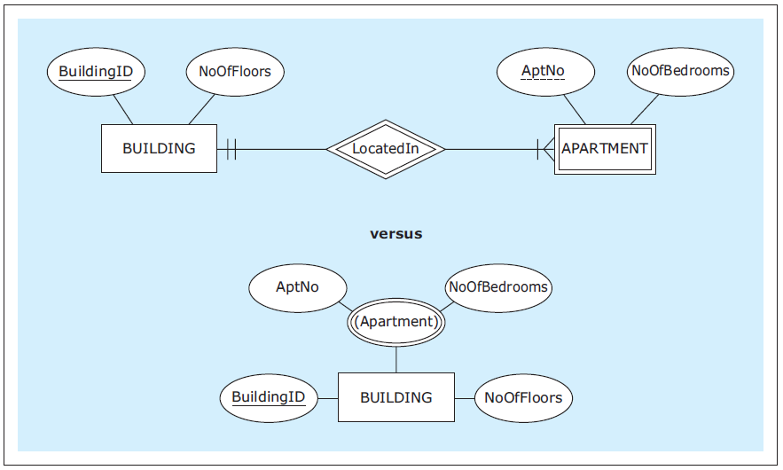
WEAK ENTITY
A weak entity versus a multivalued composite attribute
Notes:
This example is discussed and a comparison between weak entities and multivalued composite attributes is given on Pages 31-32.

Slide 39
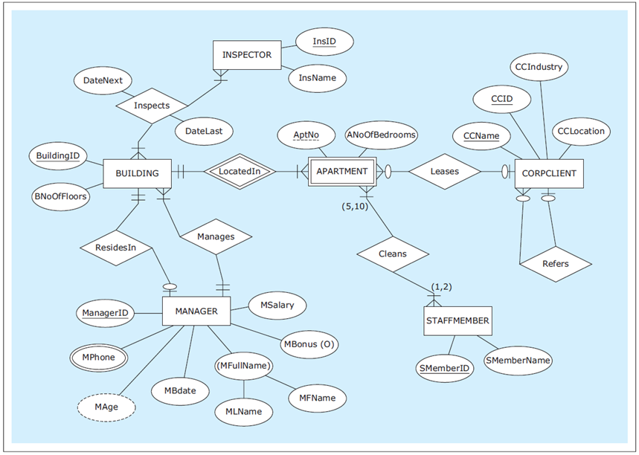
Another ER diagram example: HAFH Realty Company Property Management Database
Notes:
HAFH Realty Company Property Management Database requirements are given on Pages 35-36.

Slide 40
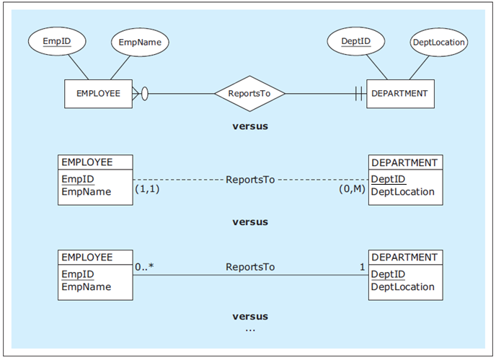
VARIOUS ER NOTATIONS
Examples of various ER notations
Notes:
These notations are discussed on Page 39.

Slide 41
Mapping relationships into relational database constructs
Mapping 1:M Relationships
Mapping M:N Relationships
Mapping 1:1 Relationships

Slide 42
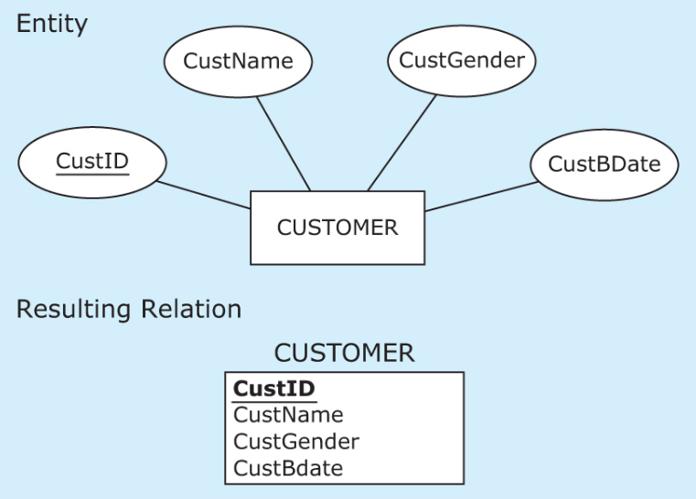
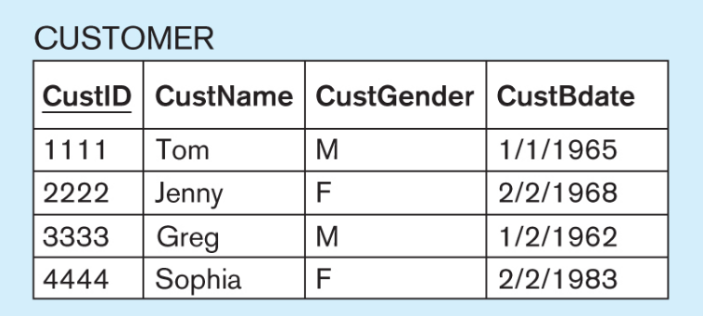
ERD
unique
Relational Scheme
Instance

Slide 43
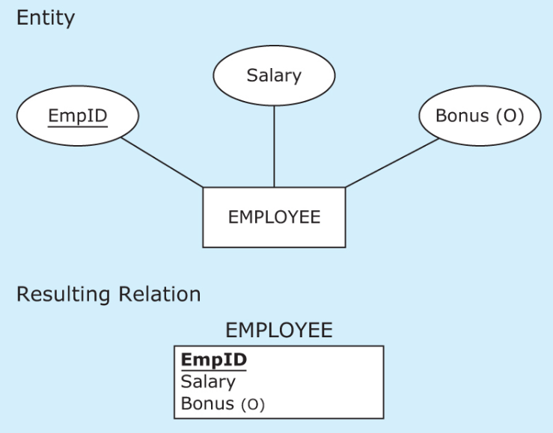
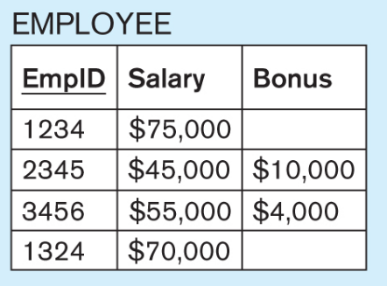
ERD
Unique
Optional
Relational Scheme
Instance

Slide 44
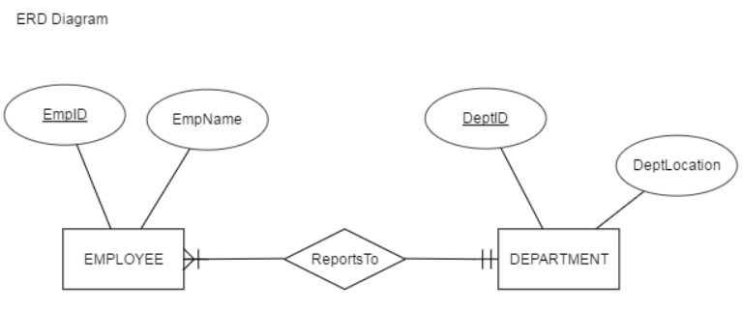
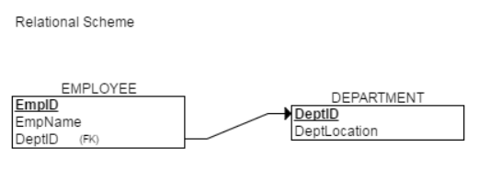
Mapping 1:M Relationships
CREATE TABLE DEPARTMENT
(
DeptID INT NOT NULL,
DeptLocation INT NOT NULL,
PRIMARY KEY (DeptID)
);
CREATE TABLE EMPLOYEE
(
EmpID INT NOT NULL,
EmpName INT NOT NULL,
DeptID INT NOT NULL,
PRIMARY KEY (EmpID),
FOREIGN KEY (DeptID) REFERENCES DEPARTMENT(DeptID)
);

Slide 45
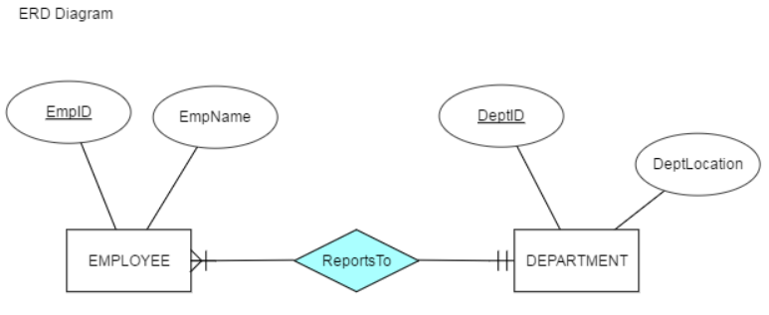
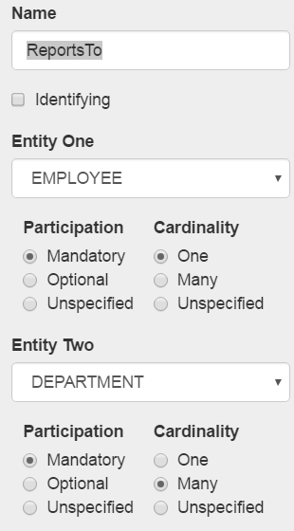
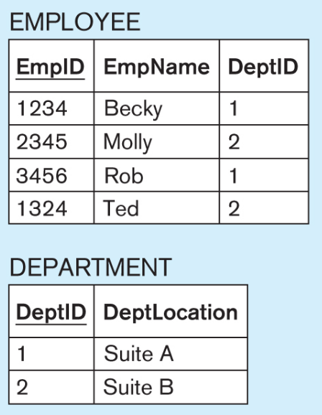
ReportsTo Relationship
DEMO:
https://erdplus.com/#/edit-diagram/218422

Slide 46
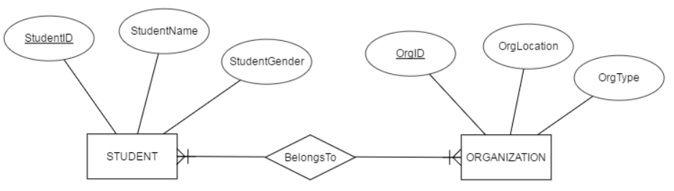

Mapping M:N Relations 1/2
CREATE TABLE BelongsTo
(
StudentID INT NOT NULL,
OrgID INT NOT NULL,
PRIMARY KEY (StudentID, OrgID),
FOREIGN KEY (StudentID) REFERENCES STUDENT(StudentID),
FOREIGN KEY (OrgID) REFERENCES ORGANIZATION(OrgID)
);
CREATE TABLE STUDENT
(
StudentID INT NOT NULL,
StudentName INT NOT NULL,
StudentGender INT NOT NULL,
PRIMARY KEY (StudentID)
);
CREATE TABLE ORGANIZATION
(
OrgID INT NOT NULL,
OrgLocation INT NOT NULL,
OrgType INT NOT NULL,
PRIMARY KEY (OrgID)
);

Slide 47

Mapping M:N Relations 2/2

Slide 48


Mapping 1:1 Relations 1/2
CREATE TABLE EMPLOYEE
(
EmpID INT NOT NULL,
EmpName INT NOT NULL,
PRIMARY KEY (EmpID)
);
CREATE TABLE VEHICLE
(
VehicleID INT NOT NULL,
VehicleType INT NOT NULL,
EmpID INT NOT NULL,
PRIMARY KEY (VehicleID),
FOREIGN KEY (EmpID) REFERENCES EMPLOYEE(EmpID)
);

Slide 49

Mapping 1:1 Relations 2/2
CREATE TABLE EMPLOYEE
(
EmpID INT NOT NULL,
EmpName INT NOT NULL,
PRIMARY KEY (EmpID)
);
CREATE TABLE VEHICLE
(
VehicleID INT NOT NULL,
VehicleType INT NOT NULL,
EmpID INT NOT NULL,
PRIMARY KEY (VehicleID),
FOREIGN KEY (EmpID) REFERENCES EMPLOYEE(EmpID)
);

Slide 50
Referential integrity constraints
Referential Integrity
MOT NULL
UNIQUE
User Defined

Slide 51


Referential Integrity Constraints
Referential integrity constraints are relational database rules that defines values that are valid for use in foreign keys.

Slide 52

Mapping Unary Relationships

Slide 53

Mapping Weak Entity

Slide 54




Slide 55

Example: Mapping an ER Diagram into a Relational Scheme 1/3

Slide 56

Example: Mapping an ER Diagram into a Relational Scheme 2/3

Slide 57

Example: Mapping an ER Diagram into a Relational Scheme 3/3

